Slide 1
Hardware Development and Field Testing
Nils Ryden, Ph.D., and Josefin Starkhammar, Ph.D.
Norrfee Tech AB, Lund, Sweden

Slide 2
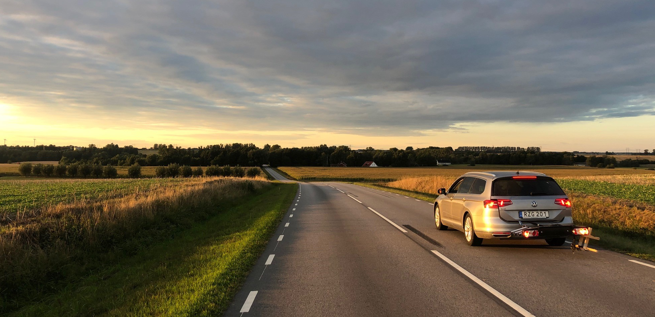
Task 2 - Hardware Development and Field Testing

Slide 3
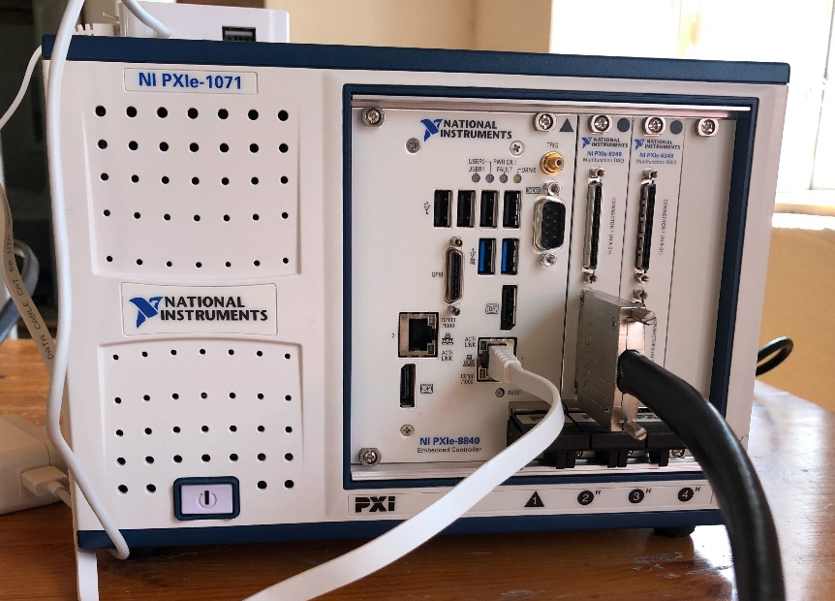
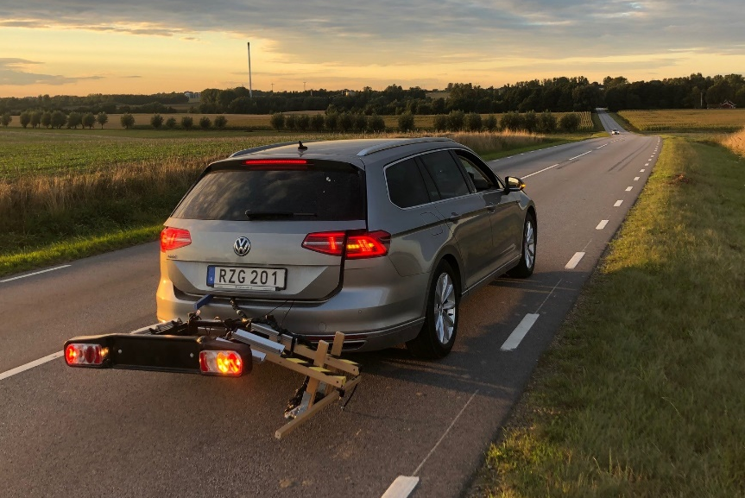
Task 2 - Hardware Development & Testing
Current testing and development for the final configuration of the new 1D array
1. Programming and configuration of new 64-channel DAQ
- Development of new DAQ software including temperature and GPS
- New optimized file format
2. Field testing with old 1D array and old 48-channel DAQ
- Optimize the new array for this MnDOT project in terms of number of channels / array and receiver distance
- Development of robust source with about 3 feet impact separation
- Field testing at warmer temperatures (~96° F)

Slide 4
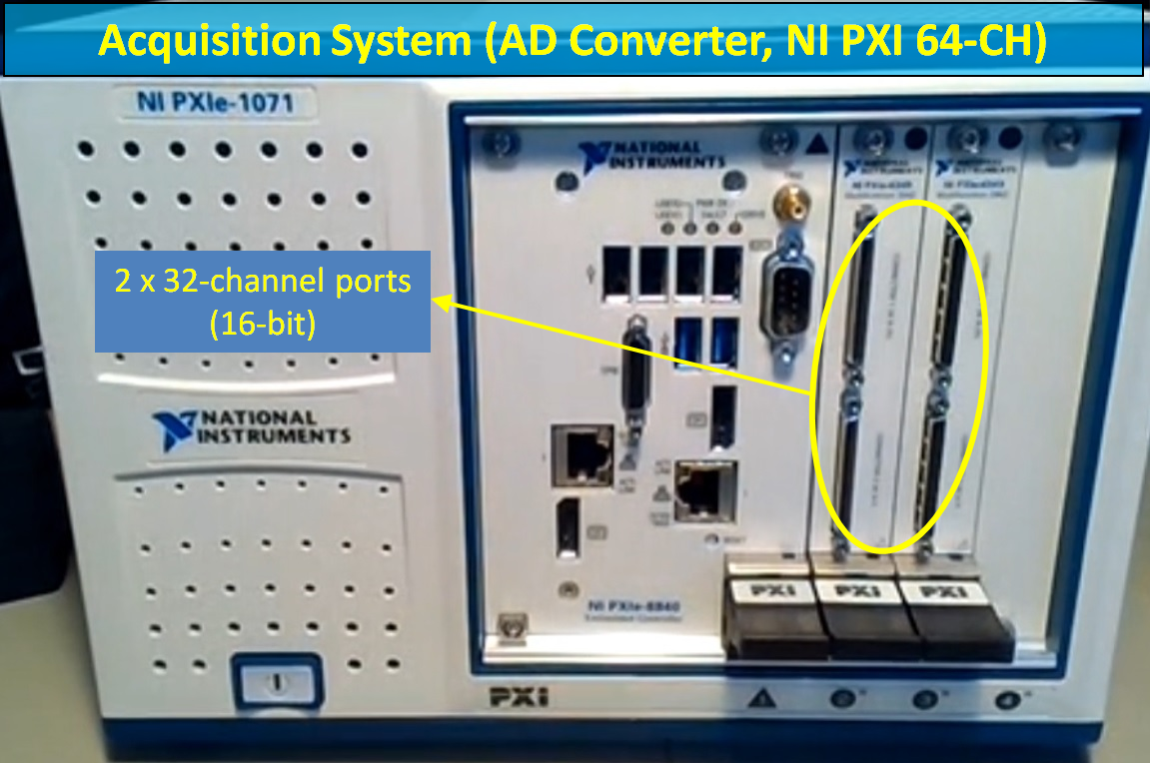
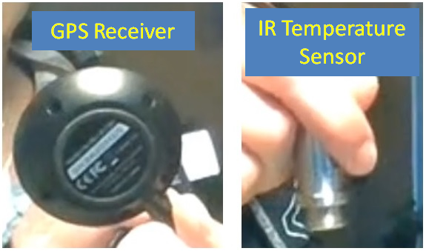
1. Programming and configuration of new 64-channel DAQ
A 64-Channel NI PXIe system (2 x 32-Channel, 16-bit, expandable up to 96-Channel)
GPS for survey coordinates
IR sensor for surface temperature.

Slide 5
1. Programming and configuration of new 64-channel DAQ
DAQ software challenges:
Fast analog trig and re-trig requirements
Asynchronous sampling of temperature IR sensor and GPS compared to microphones
Large amounts of data to be handled in several parts of the program and streamed to disk
Need for practical UI for our initial field tests
Hardware safe and data safe error handling
Future compatibility with “ParkSEIS-HMA” GUI

Slide 6
UI Controls Loop
- User event driven actions
DAQ software challenges:
Fast analog trig and re-trig requirements
Asynchronous sampling of temperature IR sensor and GPS compared to microphones
Large amounts of data to be handled in several parts of the program and streamed to disk
Need for practical UI for initial field tests
Hardware safe and data safe error handling
Future compatibility with “ParkSEIS-HMA” GUI
Solution:
Six parallel “independent” loops distributed over four cores (Intel® Core™ i7 5700EQ processor)
State machine design combined with the producer-consumer based data acquisition method optimizes # of recordable impacts per foot
Measurement Loop
State Machine design with states:
-INITIATE HARDWARE
-SAMPLE MICROPHONES
-RE-TRIG MEASUREMENTS
-OUTPUT DATA TO OTHER LOOPS
-ERROR HANDLING
Display Loop
- Displays runtime data
GPS Communication Loop
- Handles GPS communication
Temp and GPS output Loop
Outputs current temp and GPS data to Measurement Loop
Data Logging Loop
- Streams data to file

Slide 7
UI Controls Loop
- User event driven actions
DAQ software challenges:
Fast analog trig and re-trig requirements
Asynchronous sampling of temperature IR sensor and GPS compared to microphones
Large amounts of data to be handled in several parts of the program and streamed to disk
Need for practical UI for initial field tests
Hardware safe and data safe error handling
Future compatibility with “ParkSEIS-HMA” GUI
Solution:
Six parallel “independent” loops distributed over four cores (Intel® Core™ i7 5700EQ processor)
State machine design combined with the producer-consumer based data acquisition method optimizes # of recordable impacts per foot
Measurement Loop
State Machine design with states:
-INITIATE HARDWARE
-SAMPLE MICROPHONES
-RE-TRIG MEASUREMENTS
-OUTPUT DATA TO OTHER LOOPS
-ERROR HANDLING
Display Loop
- Displays runtime data
GPS Communication Loop
- Handles GPS communication
Asynchronous
sampling
Temp and GPS output Loop
Outputs current temp and GPS data to Measurement Loop
Data Logging Loop
- Streams data to file

Slide 8
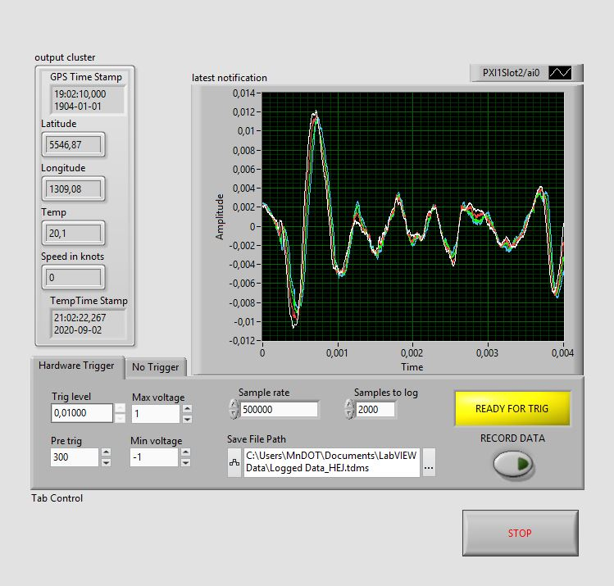
UI IN HARDWARE CONTROLING SOFTWARE
UI Controls Loop
- User event driven actions
Measurement Loop
State Machine design with states:
-INITIATE HARDWARE
-SAMPLE MICROPHONES
-RE-TRIG MEASUREMENTS
-OUTPUT DATA TO OTHER LOOPS
-ERROR HANDLING
Display Loop
- Displays runtime data
GPS Communication Loop
- Handles GPS communication
Temp and GPS output Loop
Outputs current temp and GPS data to Measurement Loop
Data Logging Loop
- Streams data to file

Slide 9
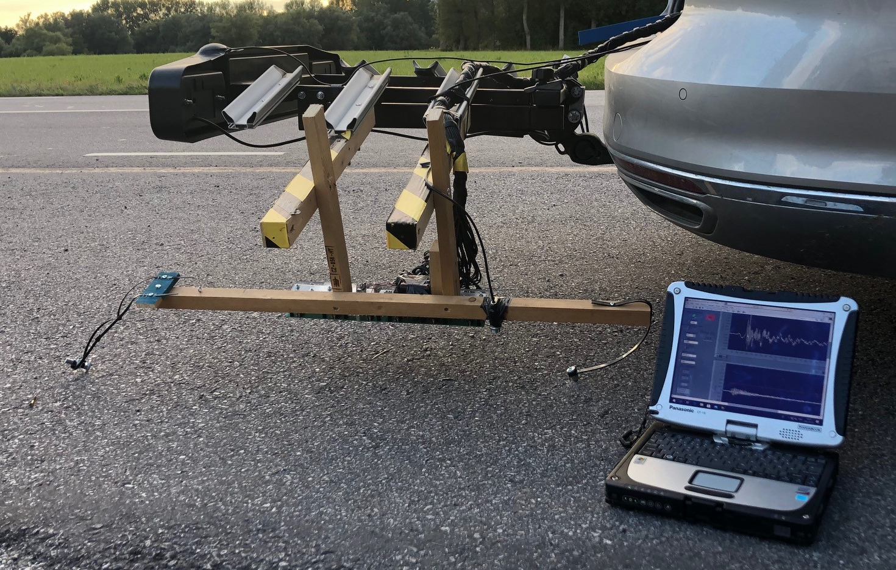
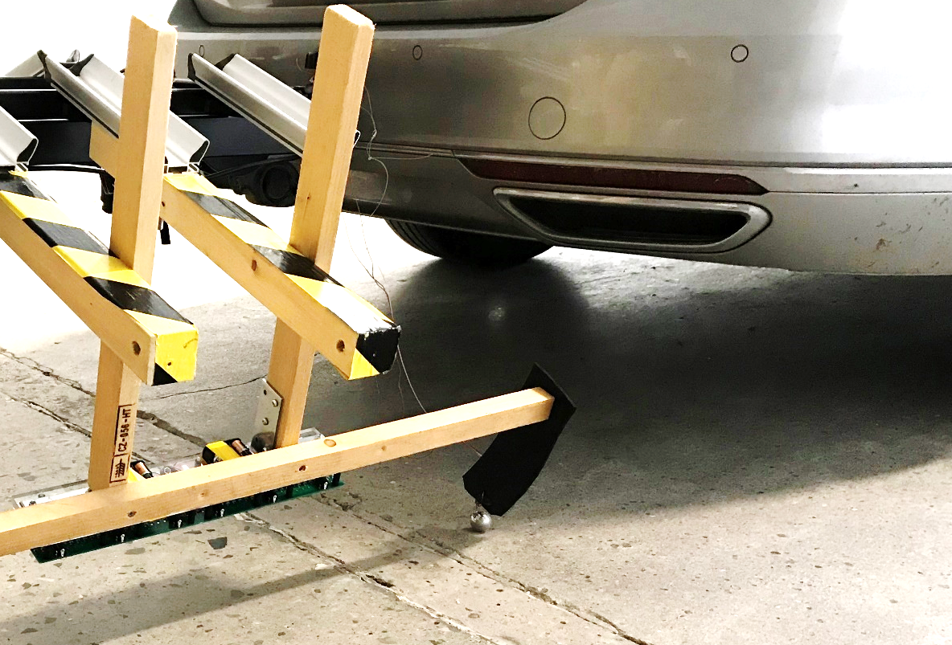
2. Field testing with old 1D array and old 48-channel DAQ
Optimize the new array for this MnDOT project in terms of number of channels / array and receiver distance
Development of robust source with about 3 feet impact separation
Field testing at warmer temperatures (~96° F)

Slide 10
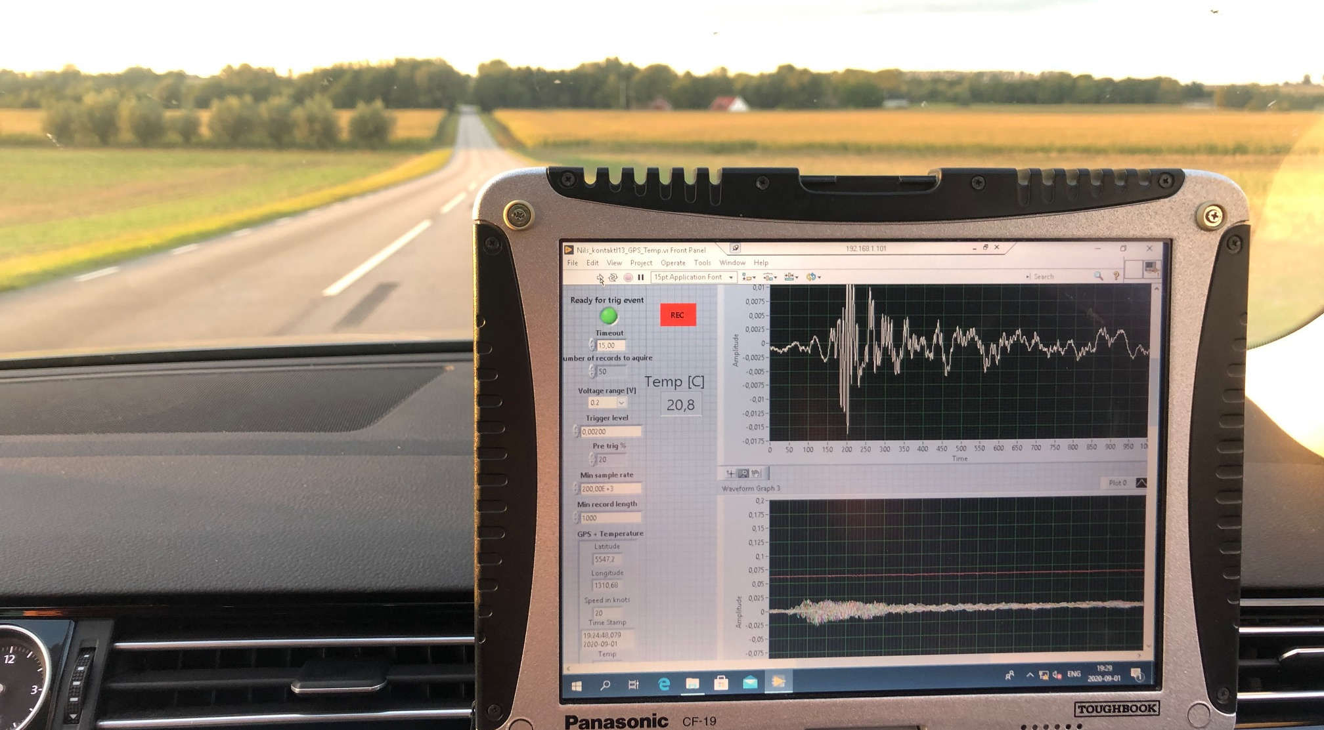

Slide 11
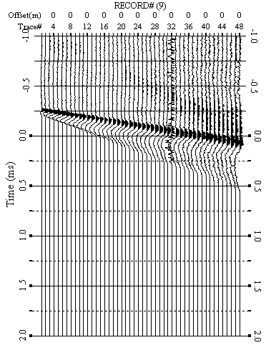
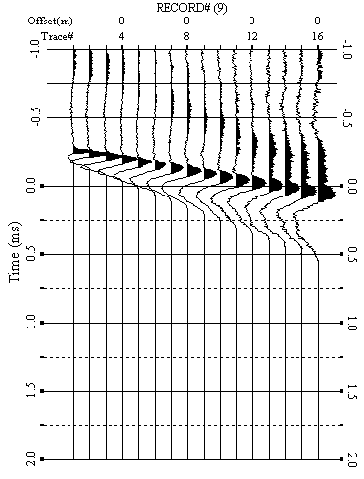
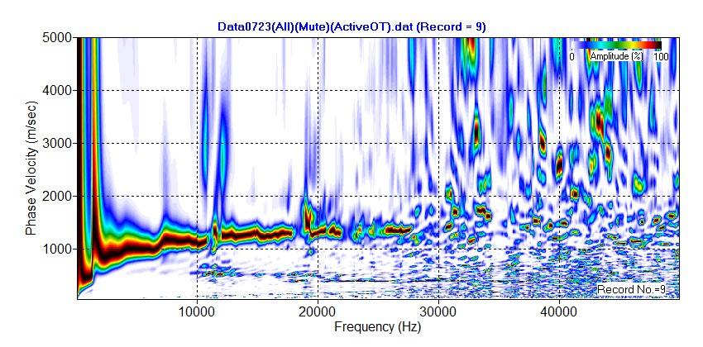
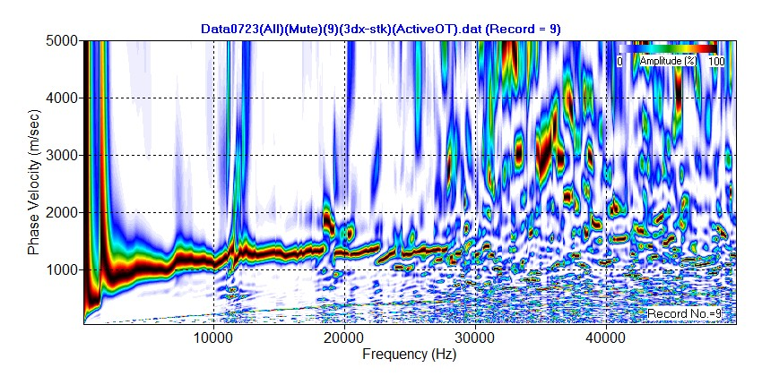
Full (48-CH)
3dx-stk (16-CH)
Full (48-CH)
3dx-stk (16-CH)
Data July 2020 (30° C or 86° F )
Vs HMA ~ 1500 m/s

Slide 12
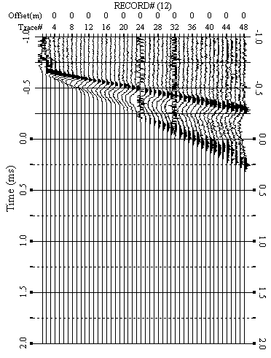
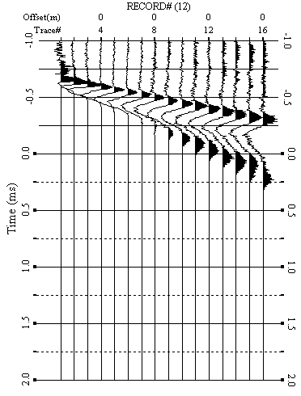
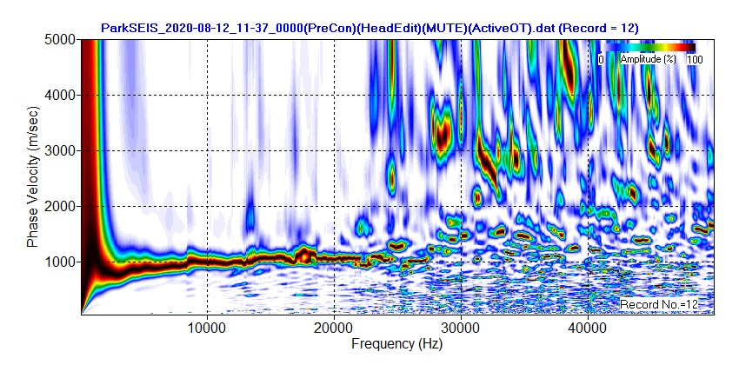
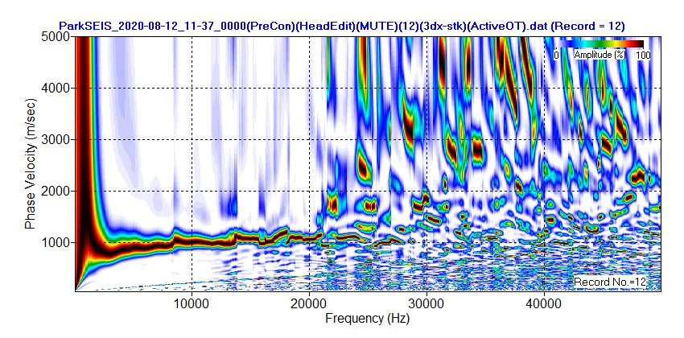
Full (48-CH)
3dx-stk (16-CH)
Full (48-CH)
3dx-stk (16-CH)
Data August 2020 (35° C or 96° F )
Vs HMA ~ 1100 m/s

Slide 13
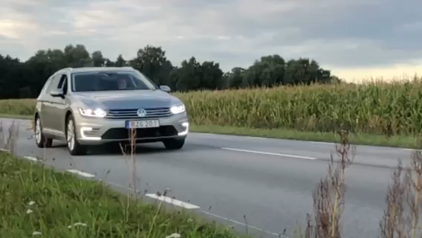
2. Field testing with old 1D array and old 48-channel DAQ

