Slide 1
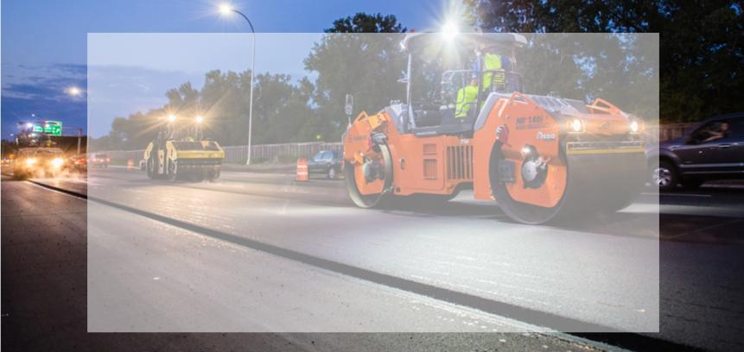

Seismic Approach to
Quality Management of Asphalt Pavement (HMA)
2020 NRRA Pavement Workshop Series
Presented
By
Choon Park, Ph.D.
Founder / Principal Geophysicist
September 3, 2020

Slide 2
Seismic Approach to Quality Management of HMA
MnDOT Contract No. 1034287 Federal Project Number: TPF-5 (341) Execution: January, 2020 - December, 2021
Principal Investigator (PI): Choon Park, Ph.D., Founder/Principal Geophysicist, Park Seismic LLC*
Co Investigator (CI): Nils Ryden, Ph.D., Research Director Norrfee Tech AB, Lund, Sweden**
Co Investigator (CI): Josefin Starkhammar, Ph.D., Founder Norrfee Tech AB, Lund, Sweden**
Administration Staff: Jin Park, Ph.D., Operations Manager/Financial Coordinator, Park Seismic LLC*
*Prime Contractor: Over-sighting Project, Development of Software Package
**Sub Contractor: Development of Hardware System

Slide 3


Slide 4
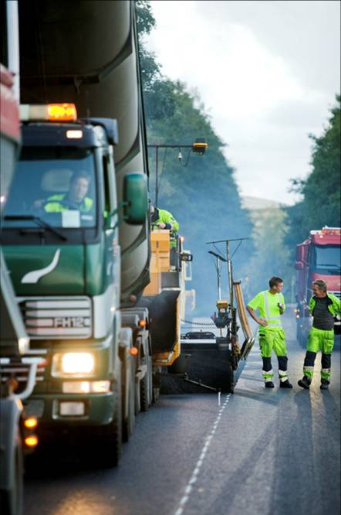
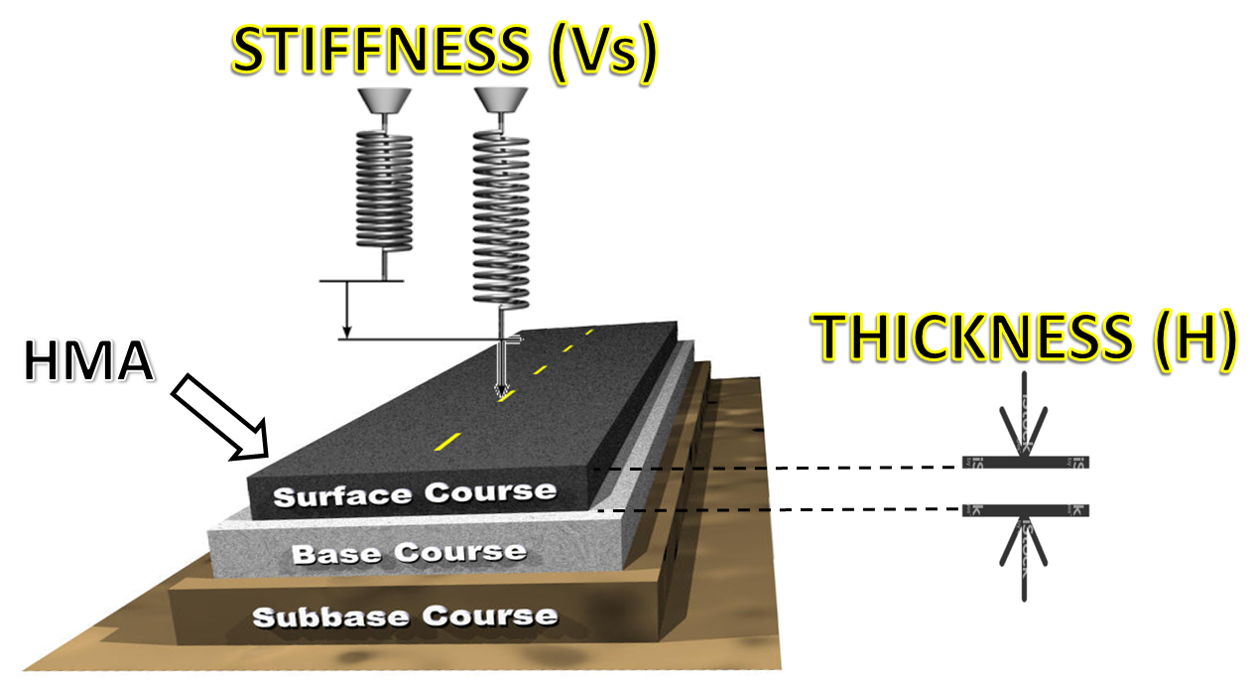
Hot Mix Asphalt (HMA) Pavement
Stiffness (e.g., Vs) and Thickness (H)
Construction and Maintenance

Slide 5
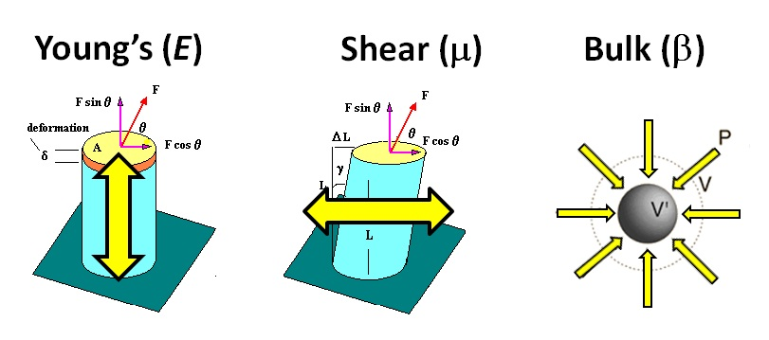
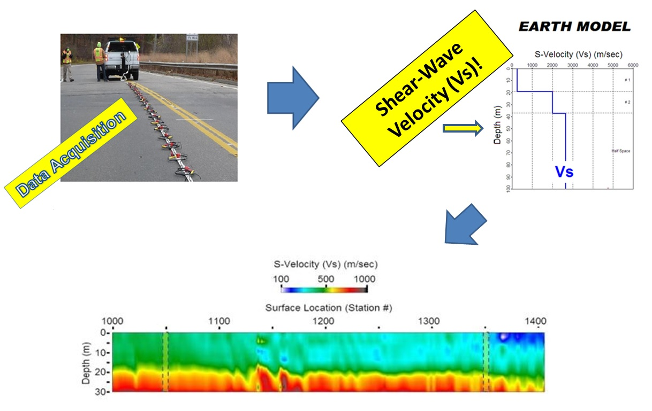
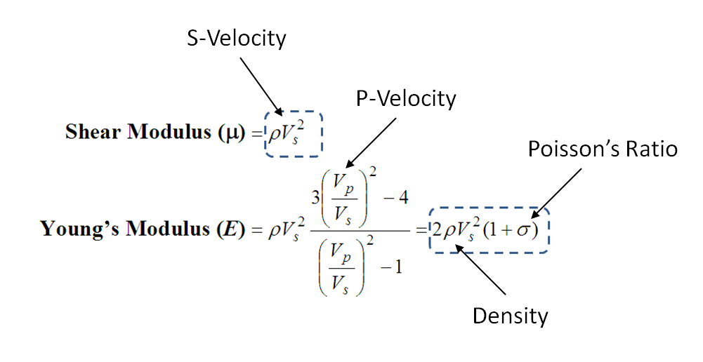
Seismic Approach − MASW
Multichannel Analysis of Surface Waves (MASW) (Park et al., 1999)
Shear-wave velocity (Vs) (1D, 2D, and 3D)
Vs − Direct indicator of “stiffness” [e.g., Young’s (E) and shear (μ)]
MASW

Slide 6
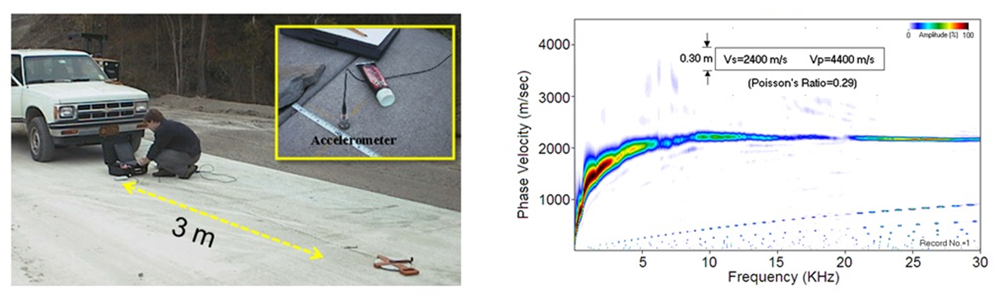
Pavement MASW (Ryden et al., 2004)
Contact measurements with accelerometer and a small hammer.
Field Measurement
Data Process
I-70 (Manhattan, KS)
Lamb wave (A0)
~0.5 Hour
~0.1 Hour

Slide 7
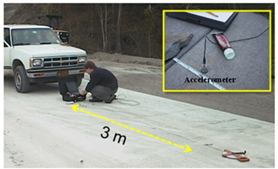
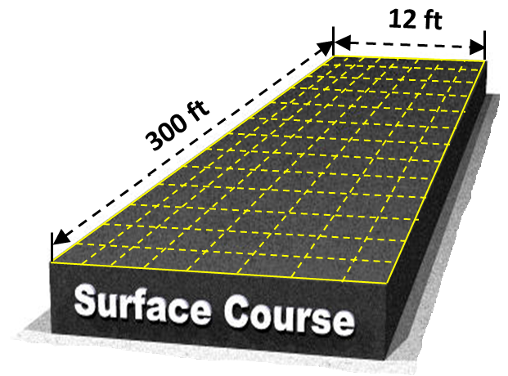

Conventional (Contact) Approach − Survey Time
(12 ft x 300 ft)
(Ryden et al., 2004)
3 ft x 3 ft resolution
Total 400 survey points
Acquisition: 400 x 0.5 hr = 200 hrs.
Processing: 400 x 0.1 hr = 40 hrs.
Total: 240 hrs.

Slide 8
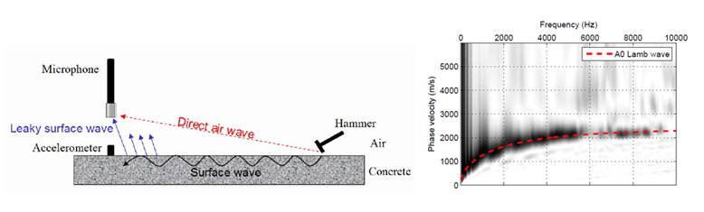
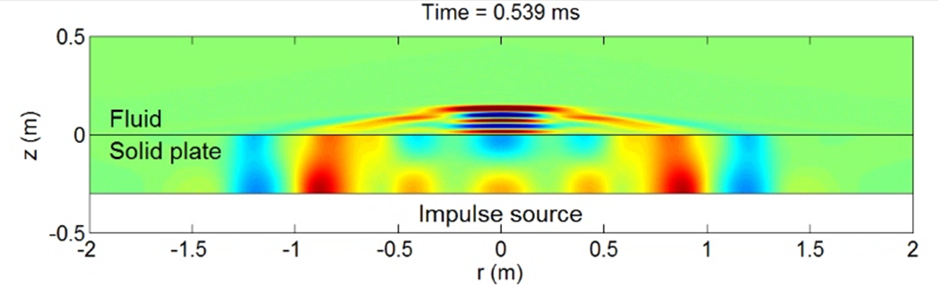
Non-Contact Pavement MASW
(Ryden et al., 2006)
Leaky
surface wave
Surface wave
Surface wave

Slide 9
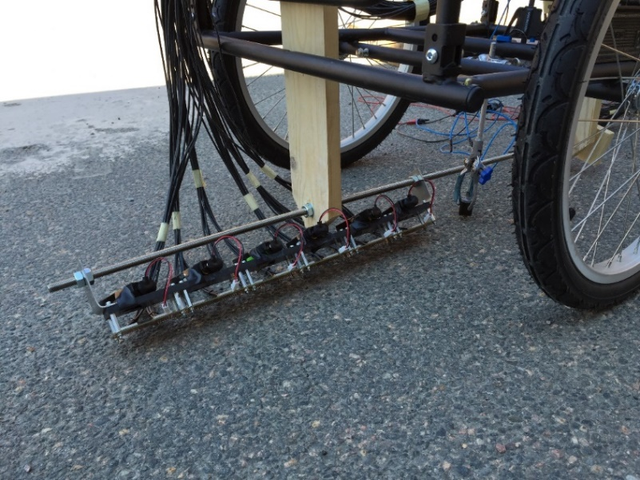
Non-Contact-Rolling Pavement MASW
(Bjurström and Ryden, 2017)
Moving Speed < 0.5 MPH
Solenoid impact source
Shear wave velocity (m/s)
48 MEMS microphone array (1-cm spacing)
SLOW!!!
Test line 4.0 m

Slide 10

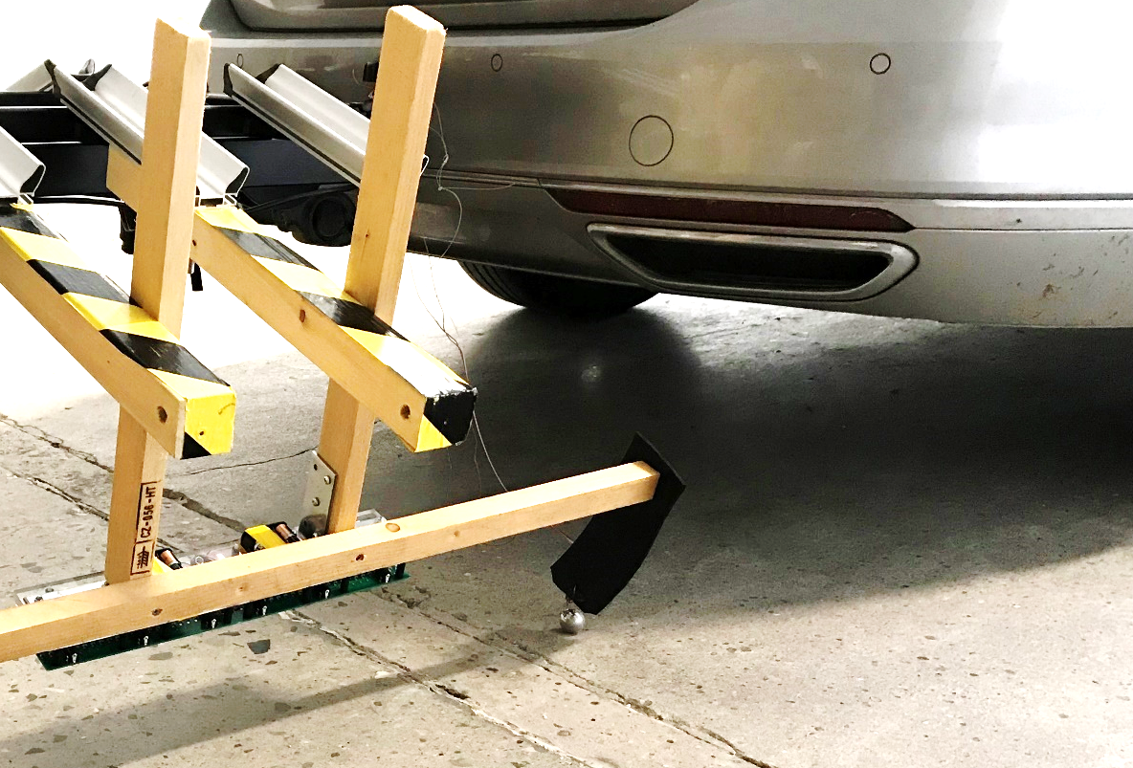
Rolling Impact Source* − “Bouncing Steel Ball”
*A 48-channel (CH) system with MEMS Microphone Array (MMA) (Ryden et al., 2019) − “SYS-RYD-2019”
48-CH MMA
Bouncing ball source!

Slide 11
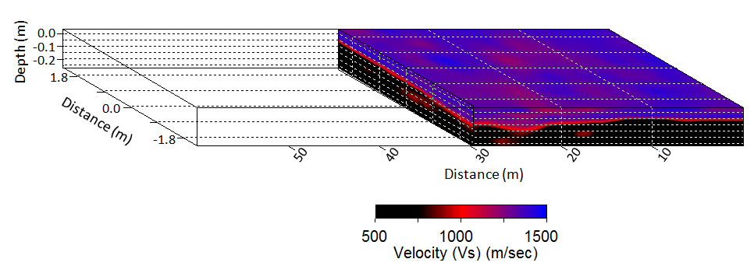
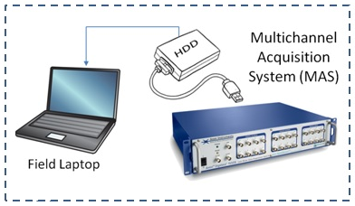
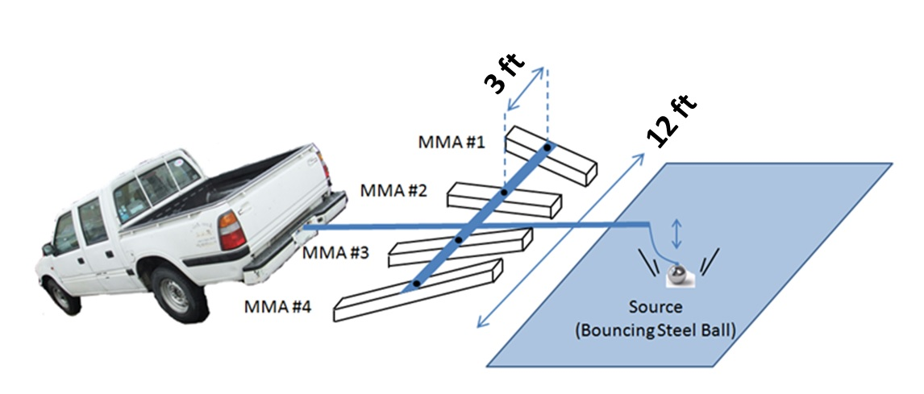
THIS PROJECT
On-Board Real Time Display
5 – 20
MPH
MMA: MEMS Microphone Array (16-CH/array?)

Slide 12
This (Non-Contact) Approach − Survey Time
(12 ft x 300 ft)
3 ft x 3 ft resolution
Total 400 survey points
Acquisition: 18 seconds @ 20 km/hr speed
Processing: 200 seconds @ 0.5 sec/record
Total: 218 seconds ( < 4 minutes)

Slide 13
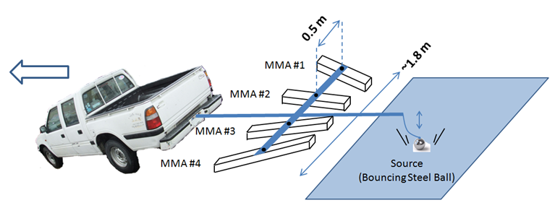

Survey Time | Contact vs. Non-Contact
240 Hours
218 seconds (< 4 min.) !!!

Slide 14
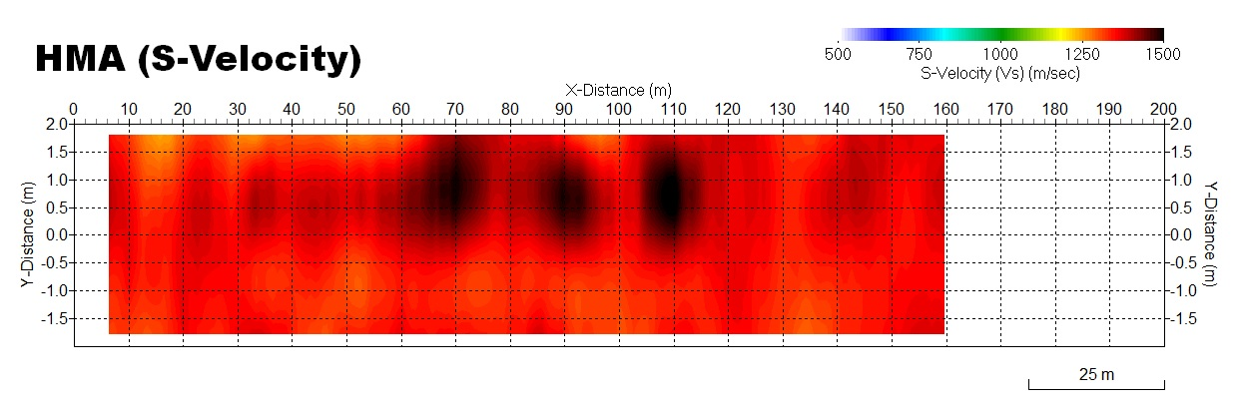
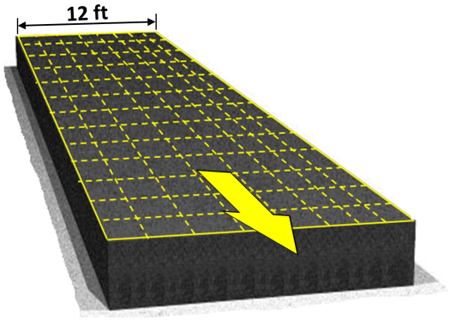
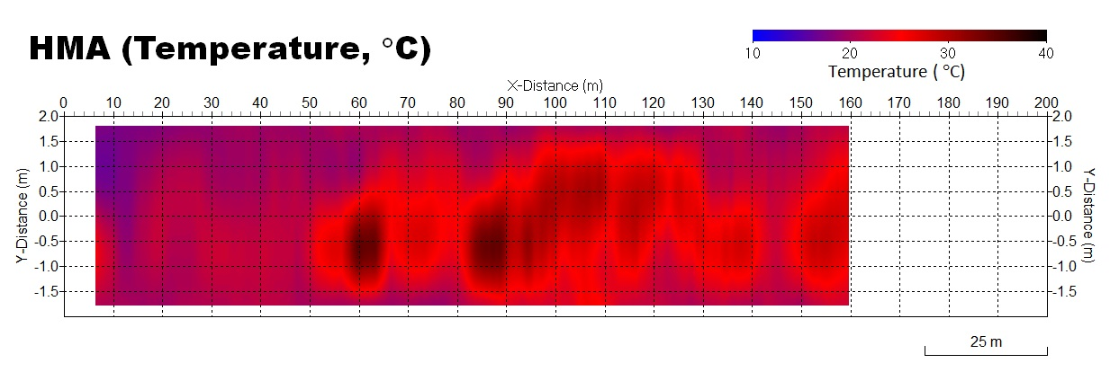
Estimated Presentation of Results
− Velocity (Vs) and Temperature −
12 ft
12 ft

Slide 15
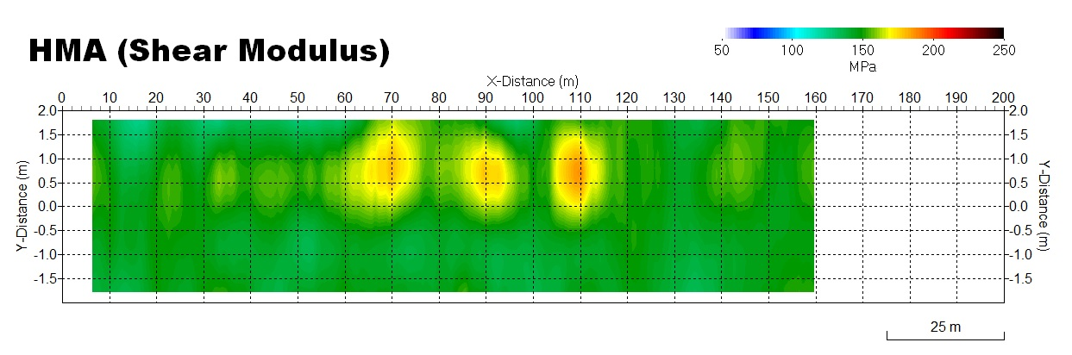
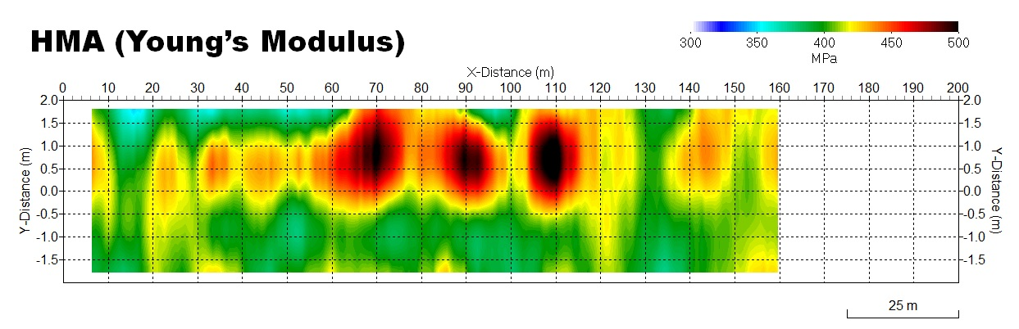
Estimated Presentation of Results
− Modulus (Shear & Young’s) −
12 ft
12 ft

Slide 16
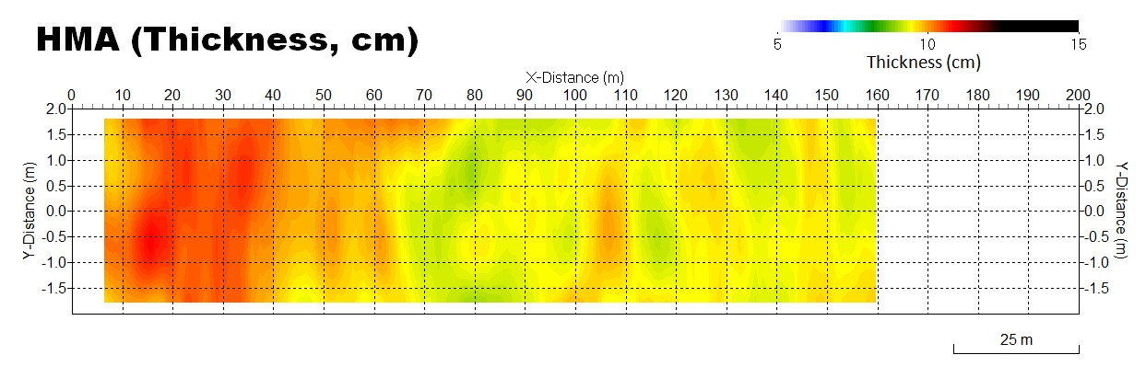
Estimated Presentation of Results
− Thickness (Lamb & Impact Echo) −
Lamb
12 ft
Impact Echo (IE)
12 ft

Slide 17
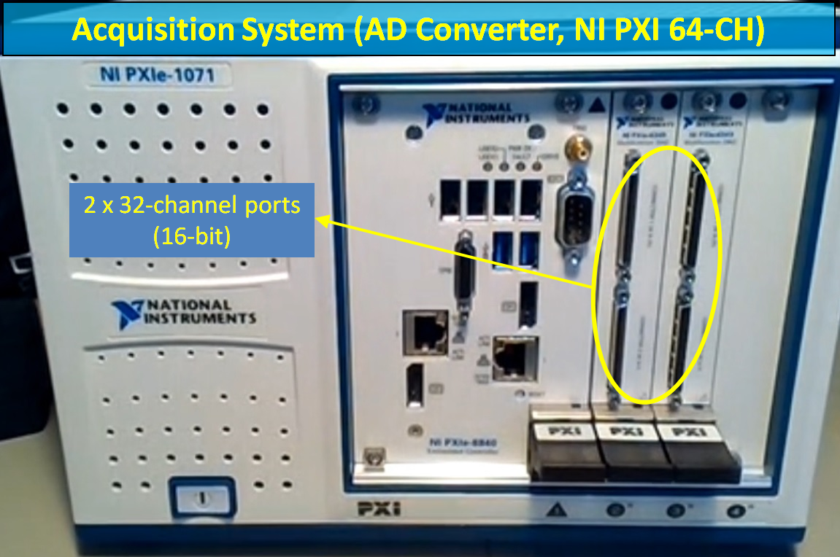
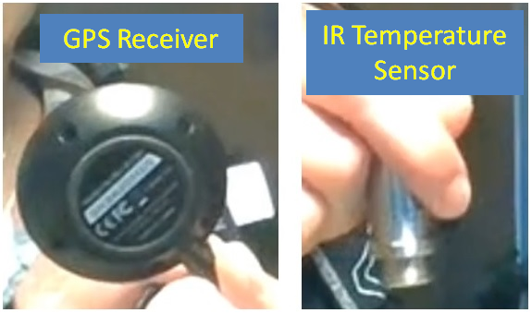
New System for This (HMA) Project − “SYS-HMA”
A 64-Channel (2 x 32-Channel, 16-bit) system (expandable up to 96-Channel)
Multiple (e.g., 4) arrays to Cover a 12-ft lane simultaneously
GPS for survey coordinates and geo-location, and IR sensor for HMA temperature.

Slide 18
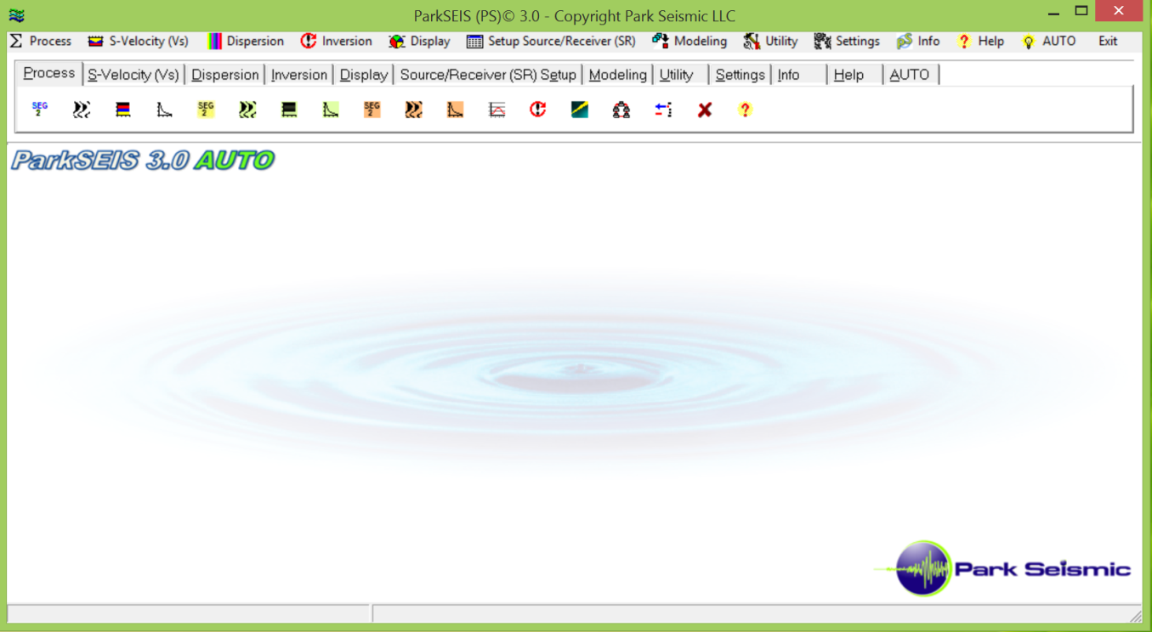
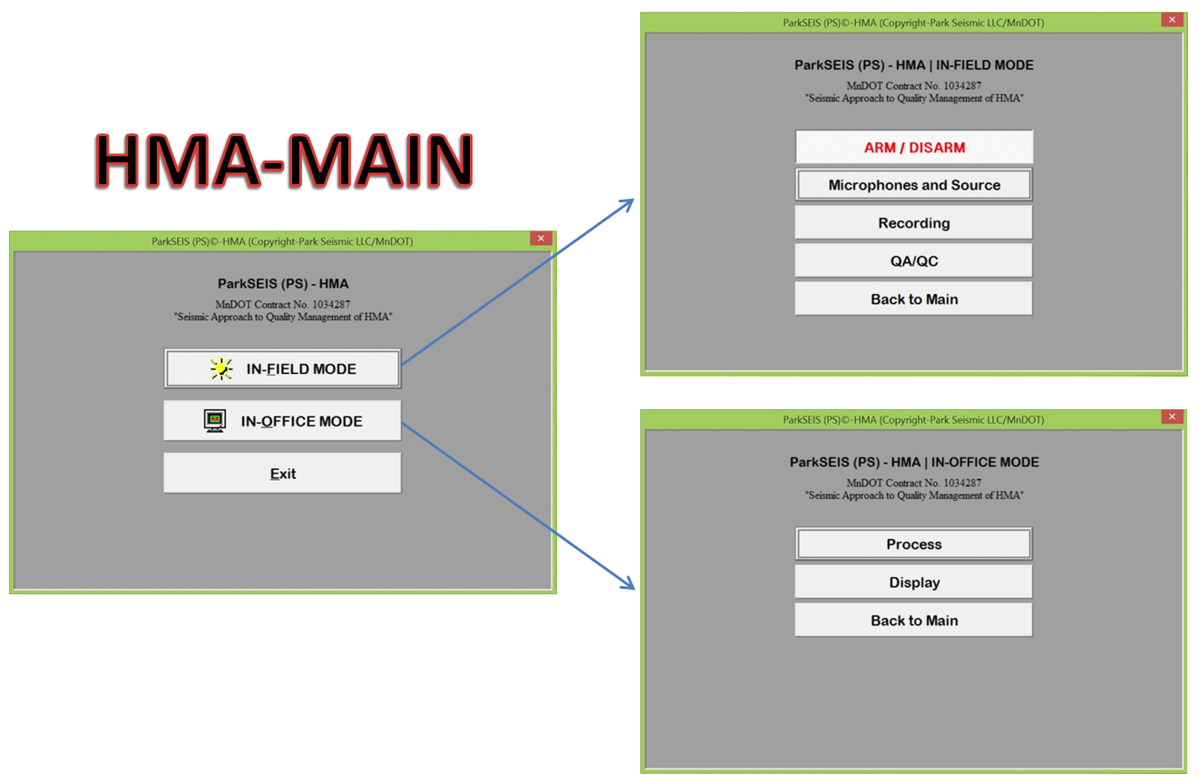
Software Package − “ParkSEIS-HMA”

Slide 19
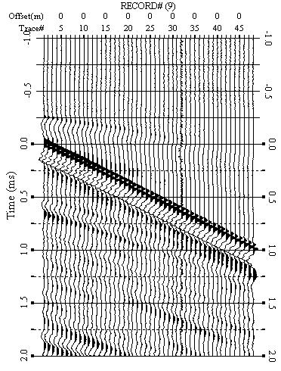
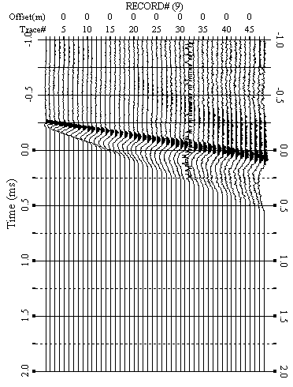
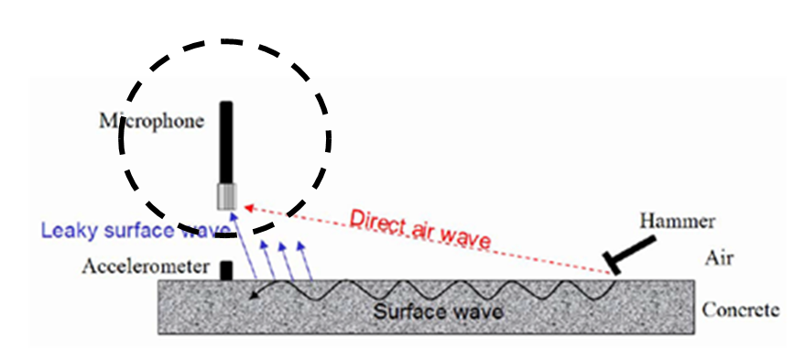
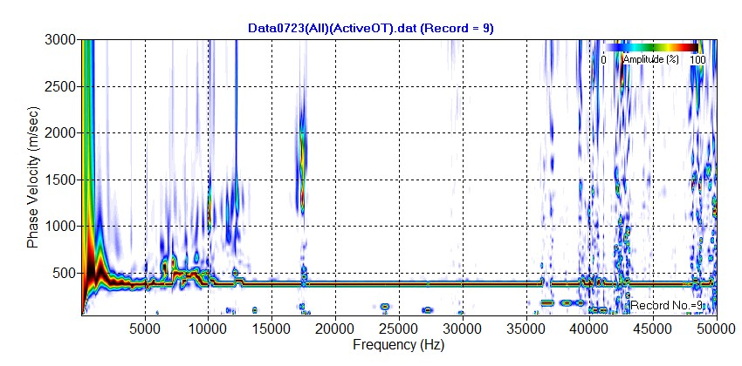
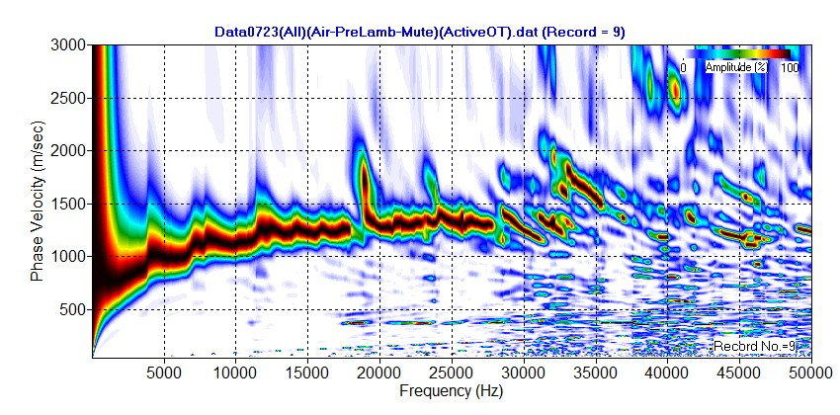
Direct Air Wave Domination
Surface (Lamb) wave
Direct air wave
Direct
air wave
RAW
MUTE
Direct air wave
Surface (Lamb) wave

Slide 20
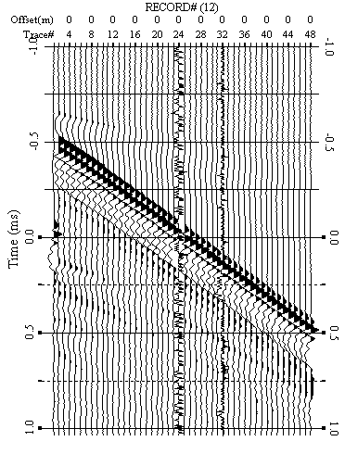
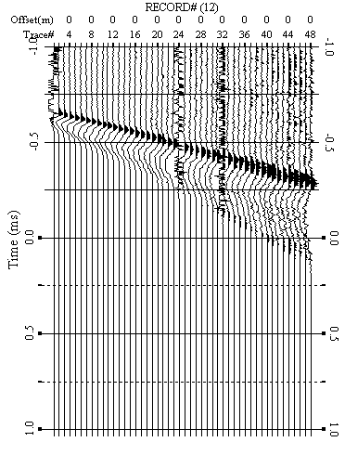
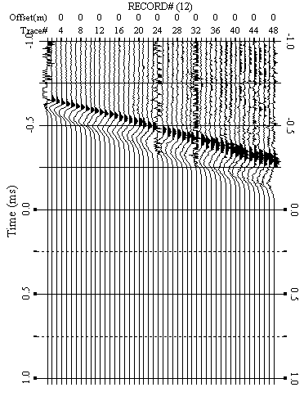
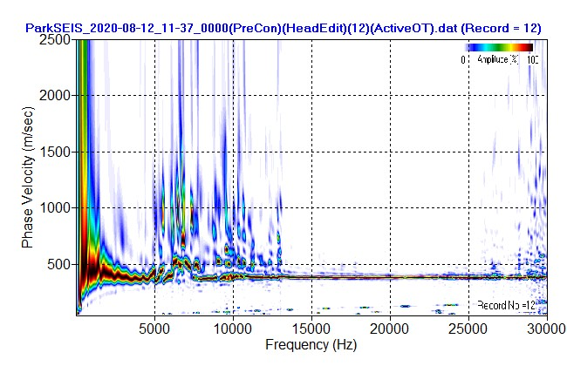
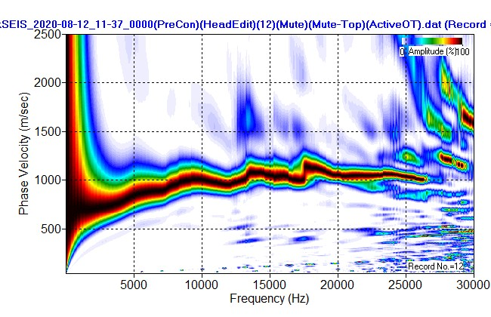
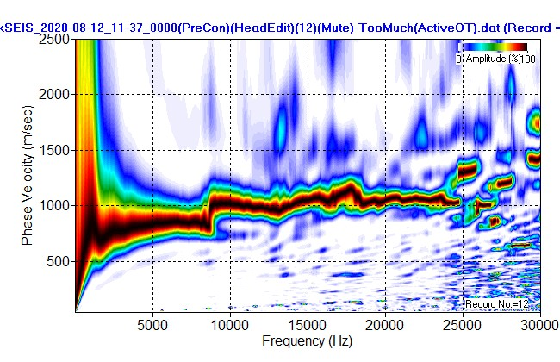
Air Wave Handling − Complications
RAW
MUTE-1
MUTE-2
?

Slide 21
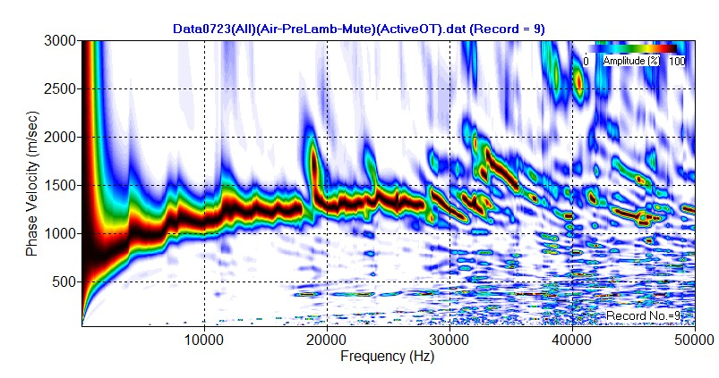
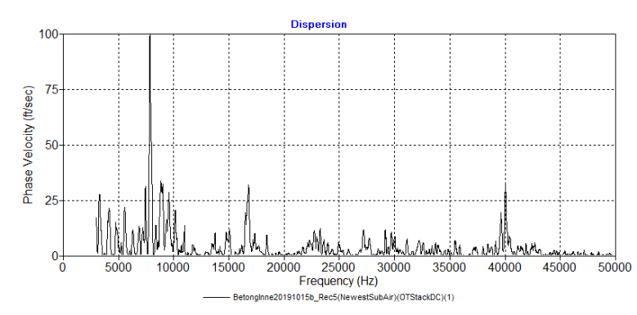
Impact Echo (IE) − Alternative H Evaluation
Surface Wave Analysis −
Velocity (Vs) and Thickness (H)
Spectral (Impact Echo) Analysis −
Thickness (H)
H = 0.260 m @ 7841 Hz
Thickness (H)
Velocity (Vs)
Amplitude (%)

Slide 22
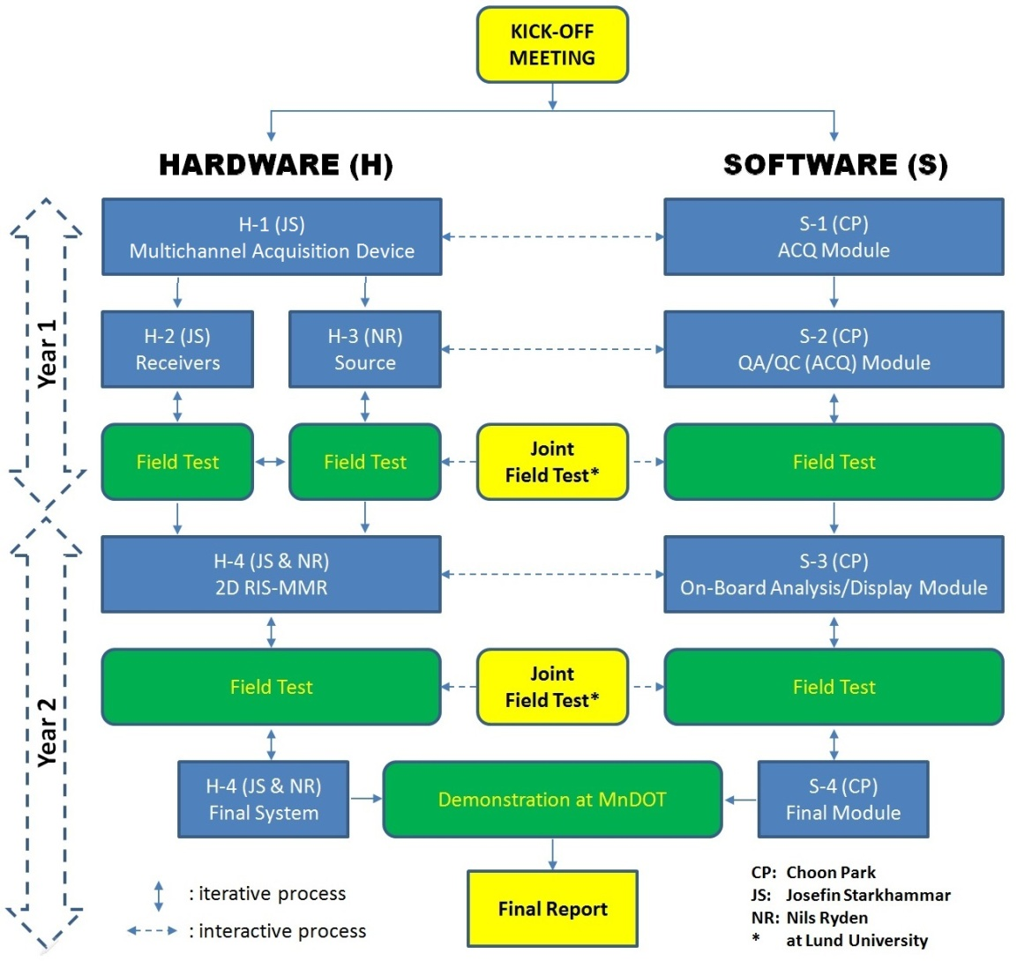
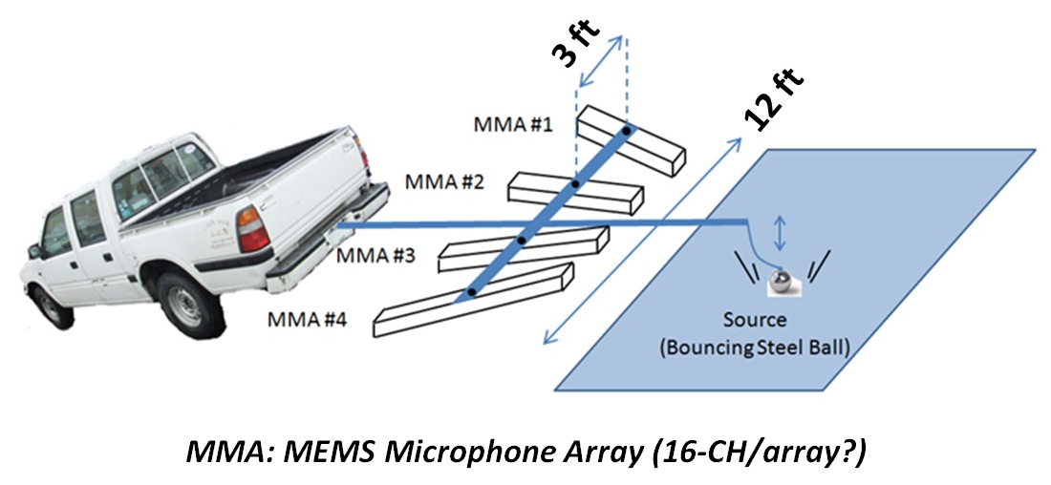
Project* Progress
Jan-2020
Hardware − Under field testing with old system to finalize the 1D array configuration (e.g., N-channel, channel spacing, etc.)
Software − ACQ and QA/QC module under development
1st Joint Field Test (JFT) − Fall, 2020 (“Remotely” Joint)
*Year 1: Completion of 1D System
*Year 2: Completion of 2D System
Now
Dec-2021

Slide 23
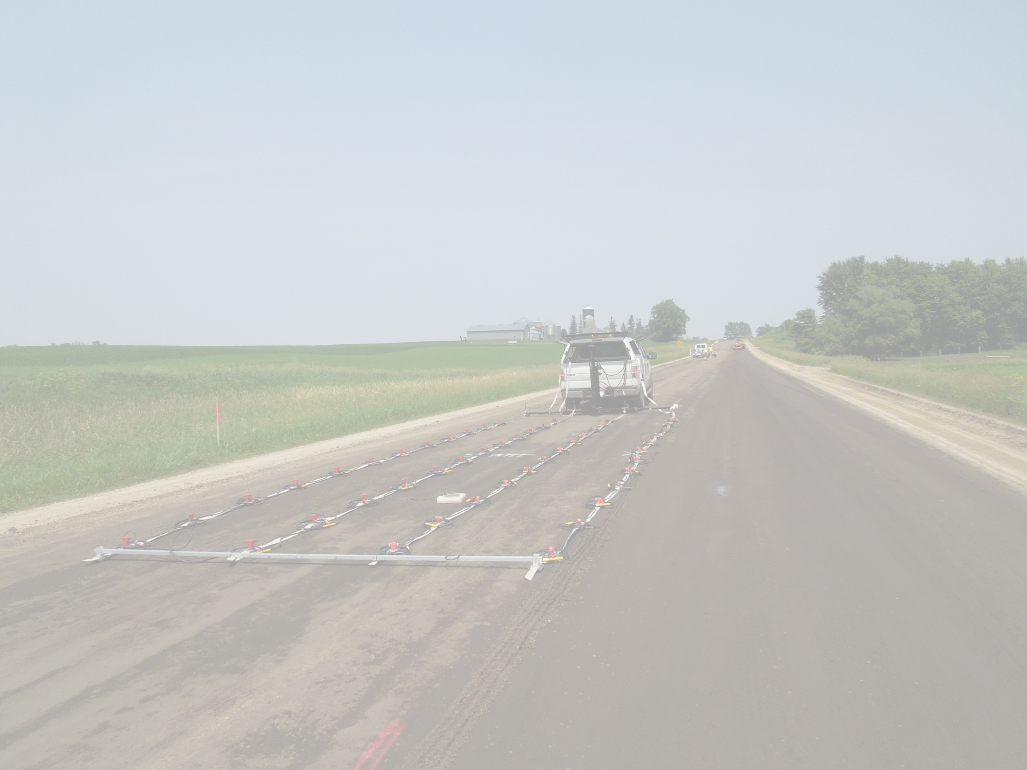


Slide 24
Hardware Development and Field Testing
Nils Ryden, Ph.D., and Josefin Starkhammar, Ph.D.
Norrfee Tech AB, Lund, Sweden

